Slide 1
AI-2002 ARTIFICIAL INTELLIGENCE
BAYESIAN NETWORK

Slide 2
Introduction
Variables having some relation with each other is to be handled.
Naïve bayes could not handle this case because it assumes that features are independent of one another
Network or graph represents the dependencies

Slide 3
Graph representation
Weather is independent of all the factors. Further up toothache and catch are conditionally independent given cavity.
Weather
cavity
Toothache
catch

Slide 4
Dependencies
P(A,B,C)= P(A) x P(B) x P(C) when a, b and c are independent of one another
P(A,B,C) suppose we say B is parent of A so it becomes then P(A|B ) x P(B) x P(C)

Slide 5
Example
A
C
B
D
E

Slide 6
Example
What is P(a,b,c,d,e) if they are mutually independent?
What is P(a,b,c,d,e) as per independence assumptions of the network provided?

Slide 7
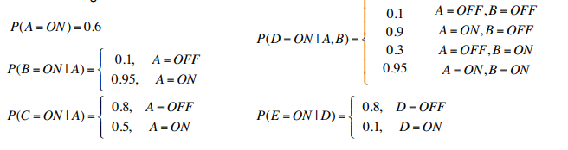

Slide 8
Example cont.
What is P(A=on, B=on, C=on, D= on, E=on)?
What is P(E=on | A=on)?
What is P(A=on | E=on)?

Slide 9
Solution
P(A=on, B=on, C=on, D= on, E=on)?
P(A=ON)P(B=ON|A=ON)P(C=ON|A=ON)P(D=ON|A=ON,B=ON)P(E=ON|D=ON) = (0.6)(0.95)(0.5)(0.95)(0.1) = 0.0271
P(E=on | A=on)?
=P(E=on, A=on)/P(A=on)
=P(B|A=ON) P(D|A=ON,B)P(E=ON|D)
In this case B and D will have different combo of on and off

Slide 10
Solution continued
=(0.1*0.9*0.05)+(0.1*0.95*0.95)+(0.8*0.05*0.95) + (0.8*0.1*0.05)
=0.13675
P(A=on | E=on)?
= P(A=on, E=on)/P(E=on)
= 0.2227

Slide 11
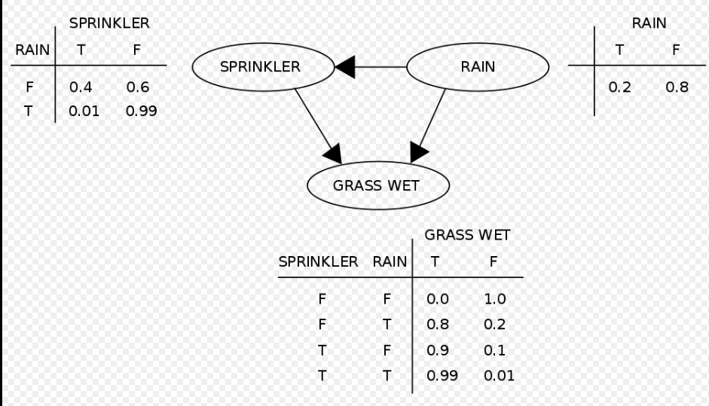

Slide 12
Question
What is P(G,S,R)?
What is P(R=T|G=T)? Ans: 0.3577

